Slide 1

Topology-Preserving Deep Learning for Structural Integrity in Optical Semiconductor Characterization at Deeply Subwavelength Resolution
Student: Yuhan Peng (U2140157H)
Supervisor: Associate Professor Xia Kelin
Project ID: MATH/24/051
Date: 21/04/2025
Notes:
Hii good afternoon Prof and peers, I’m Yuhan, Today our topic is Topology-Preserving Deep Learning model for optical semiconductor characterization under a subwavelenth resolution.

Slide 2
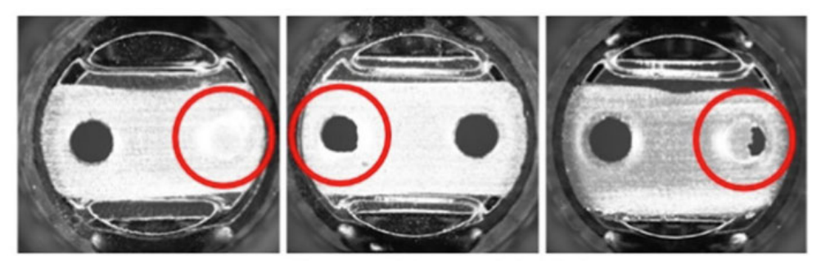

Semiconductor Defects Detection
Introduction & Background
Methodology
Experiments & Results
Semiconductor defects
Most common detection procedure: Optical inspection
Optical imaging
Microscopy
Examples of defects from LED panel
1
Notes:
Semiconductor manufacturting may lead to defects which will increase cost and slow down the manufacturing processes. Here are 2 sample defects from the LEC panel, one is circle structure defects and one is the broken line.
The current most common defect detection procedure is through optical inspection through optical imaging and microscopy either human or automatically by machine. However, if its optical related it will lead a diffraction limit problem.
Defective products increase costs and slow down manufacturing processes [1]. Timely and accurate detection of defects helps industries to apply quality control and stabilization strategies to maintain competitive edge over competition [2]
Optical inspection techniques can be subdivided into manual optical inspection (performed by a human inspector) and automatic optical inspection (AOI) which is performed by using an image sensor and processor.

Slide 3
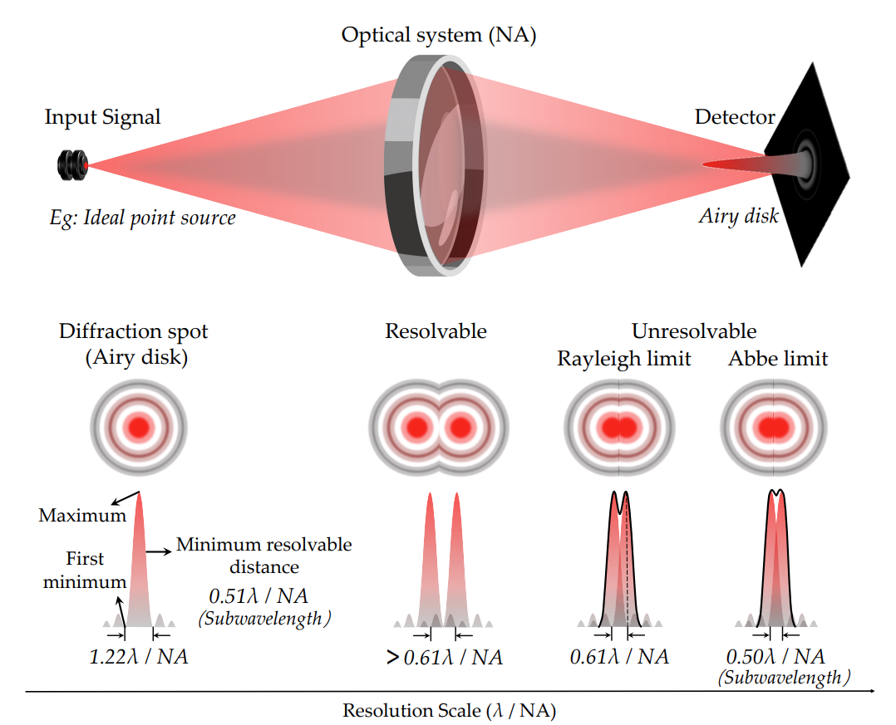
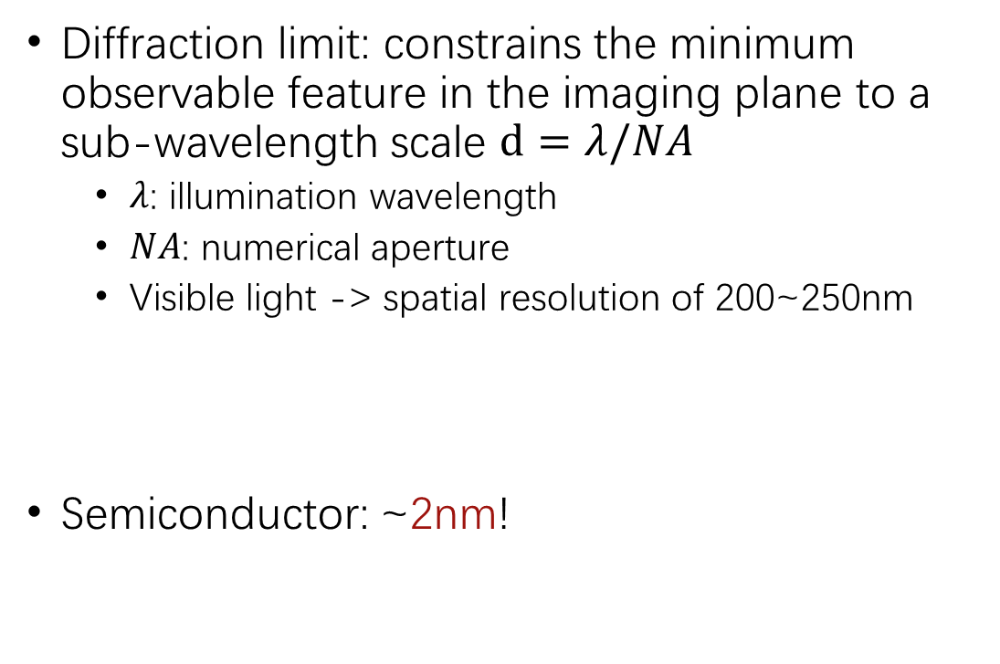
Optical Limitation: Diffraction Limit
Introduction & Background
Methodology
Experiments & Results
Diffraction limit: constrains the minimum observable feature in the imaging plane to a sub-wavelength scale $d=λ/NA$
$λ$: illumination wavelength
$NA$: numerical aperture
Visible light -> spatial resolution of 200~250nm
Semiconductor: ~2nm!
Diffraction Limit
2
Notes:
Diffraction limit, constraint the observable features to a wavelength related the size. If we are using microspoy under visible light, the resolution will be around 200 – 250 nano meter means smaller than this siz ewill be unresolvable.
Like the image shown on the left hand side, we can see that if the distance between the center of 2 signal is larger than the diffraction limit, it will be resolvable shown as 2 light spots overhere; But if its smaller than the limit, the 2 light spots will cover each other to be unresolvable. We can not see clearly what they actually looks like. Currently semiconductor becomes smaller and smaller, and even achieve single nano-meter scale. Thus they will face the diffection limit problem when we using optical inspection to do defect detections.
However, the wave nature of light manifests in diffraction, a universal phenomenon that becomes particularly pronounced when light waves interact with structures of dimensions comparable to the wavelength, fundamentally limiting the observation resolution of optical systems.
This limitation, known as diffraction limit, constrains the minimum observable feature in the imaging plane to a sub-wavelength scale d = λ/(2NA), where λ represents the illumination wavelength and NA the numerical aperture. Consequently, conventional optical microscopy using visible light is restricted to a spatial resolution of approximately 200 ∼ 250 nm
NA: In optics, the numerical aperture (NA) of an optical system is a dimensionless number that characterizes the range of angles over which the system can accept or emit light.
However, since the semiconductor becomes smaller and smaller nowadays which is some time smaller than the visible light -> so the optical detection method has problem

Slide 4
Optical Limitation: Diffraction Limit
Introduction & Background
Methodology
Experiments & Results
Semiconductor defects detection facing the diffraction limit problem
Potential Solutions:
Electron Microscopy (EM) -> vacuum environment & radiation damage
Super-resolution Microscopy -> invasive fluorescence tagging
…Deep Learning!
Image-to-image translation network (diffraction unresolvable image -> original image)
3
Notes:
We want some potential solution for this problem. One may be Electron Microscopy which achieves atomic-scale resolution. However, this need vacuum environment and will cause radial damage. Another potential solution will be the super-resolution microscopy, which wins the 2014 noble prize, but this need fluorescence tagging which can not use on metal. So we may think of about using Deep Learning, people are using image-to-image translatin network to decode the diffraction unresolvable image to the original image/signal.
We This fundamental constraint spurred the development of electron microscopy (EM) [24], notably scanning and transmission EM, which achieves atomic-scale resolution [48, 89]. However, EM requires sophisticated sample preparation protocols and vacuum environments [11, 74]. More critically, the irreversible radiation damage from high-energy electron beams prevents their application in real-time imaging of live biological
However, this approach requires invasive fluorescence tagging and complex sample preparation [16, 34], compromising the inherent benefits of optical imaging and limiting its application in real-time imaging and semiconductor metrology
在**半导体计量学（semiconductor metrology）**中，超分辨率光学显微技术的应用受到以下几个主要限制：
1. 荧光标记的不可行性
半导体器件由硅、金属、氧化物等材料组成，而超分辨率技术（如 STED、PALM、STORM）通常依赖于荧光标记（fluorescence tagging）。
在半导体制造过程中，不可能给芯片上的晶体管、电路等结构添加荧光分子，这与生物成像中的荧光染色方法不同。
这意味着许多超分辨率成像技术无法直接应用于无标记的半导体结构检测。

Slide 5
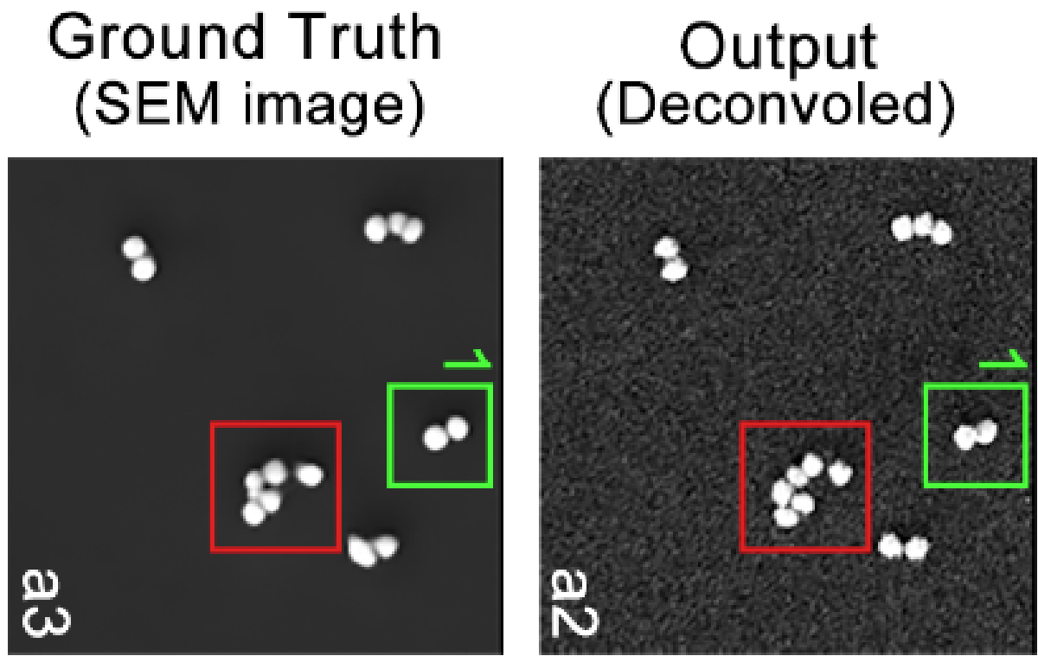
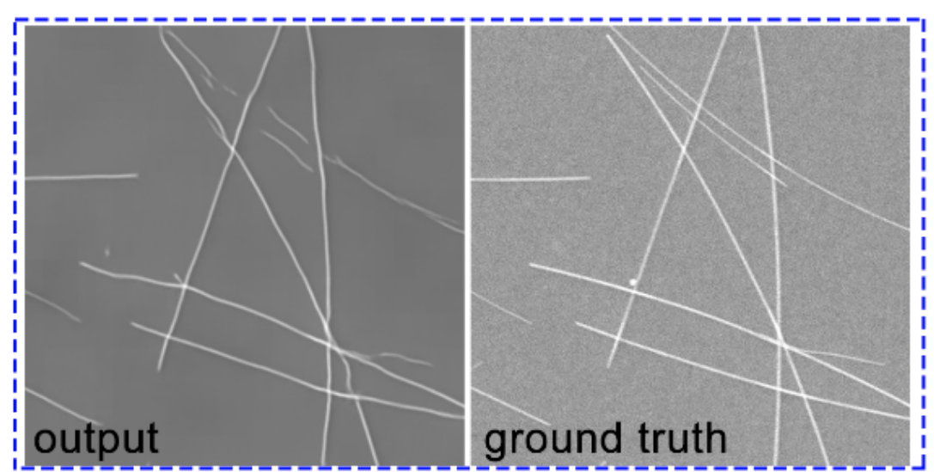
Related Works
Introduction & Background
Methodology
Experiments & Results
Recent works (Yang et al., 2021)(Hu et al., 2024) using U-Net for nano-particle and nano-line imaging
However, its pixel-wise loss function often leads to structural discontinuities
Connectivity of nano-line ×
Numbers of nano-particle ×
Topology-preserving deep learning model
(a) Inconsistency of particle positions and the misjudgment of particle number; (b) Discontinuity of line segments
4
Notes:
Recent works using U-Net for nano-partical and nano-line imaging. However, they use pixel_wise BCE loss function and lead to structure discontinuities. For example, the disconnective of nano line here, and the wrong number of nanoparticle here. We can regard the connectivity and numbers of particle both as a type of topological features, one may think they are connected components and if we want to preserve it we can preserve through the same betti number for example. And this lead to our idea of creating a topology-preserving deep learning model.

Slide 6
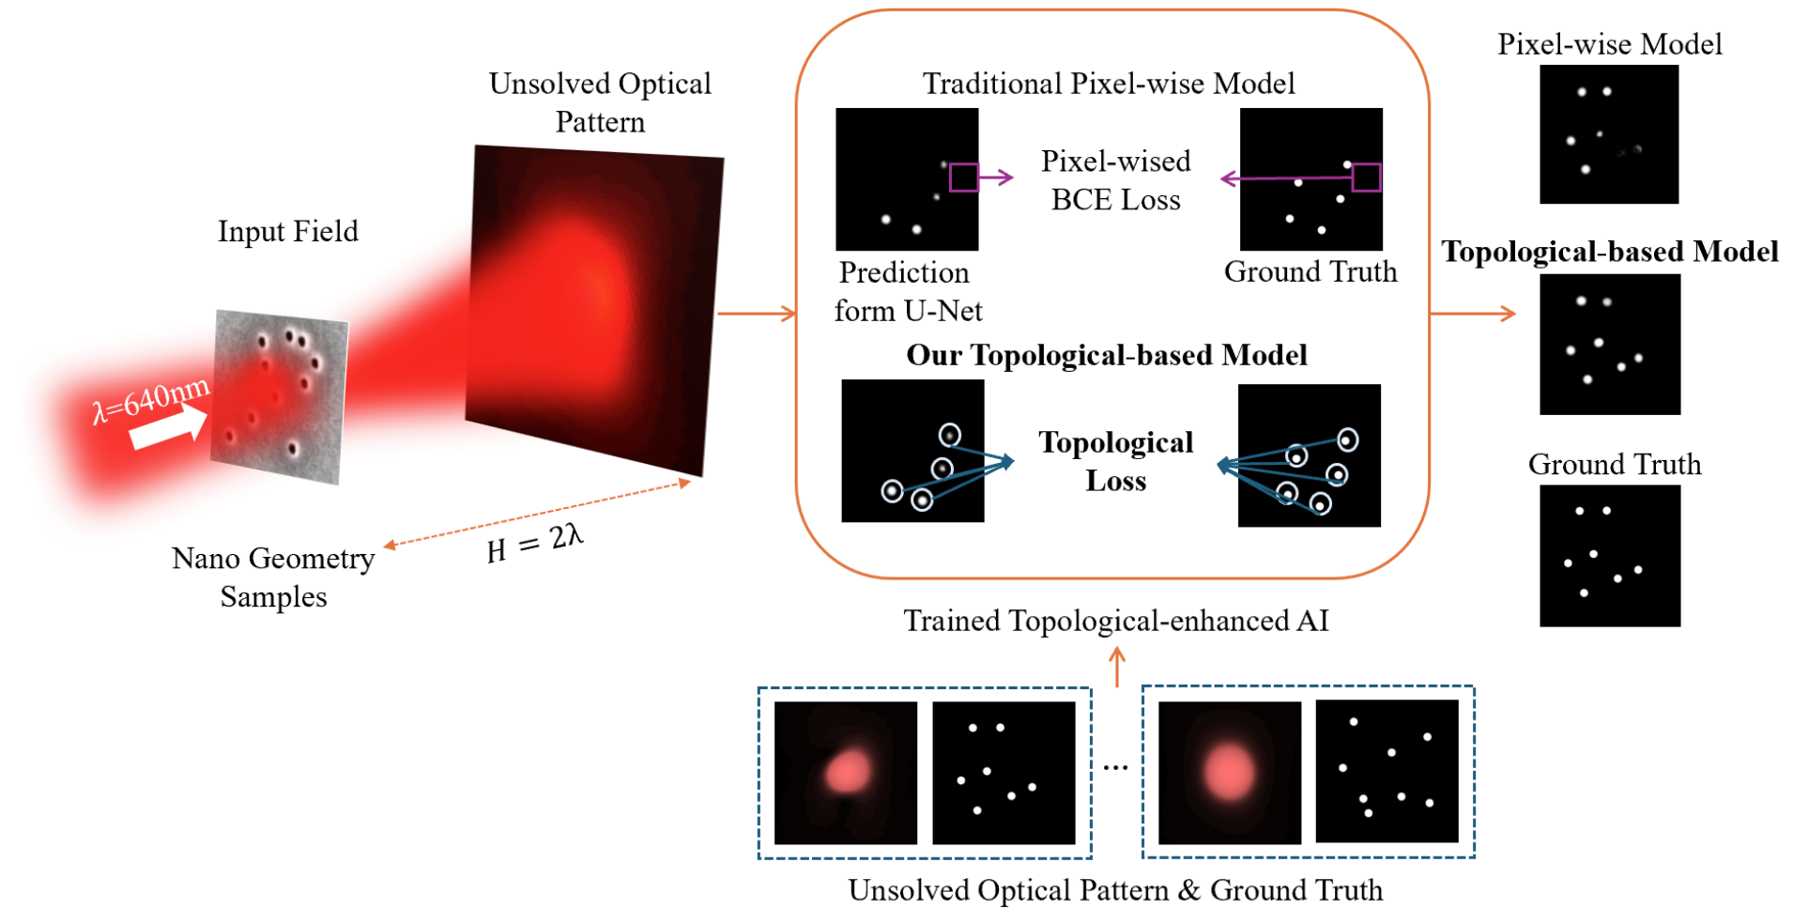
Our Contributions
Introduction & Background
Methodology
Experiments & Results
We propose a topology-enhanced deep learning framework based on persistent homology:
Conduct a multi-stage multi-directional filtration for images
Design a Lipschitz Topological Loss function
Achieve higher accuracy compared to traditional pixel-wise model
Our Framework
5
Notes:
强调consider global topological constriant
Our contribution is that we propose a topology-enhanced deep learning frame work based on persistent homology. As the overall framework shown here, the input will be the unsolved diffraction image, and we conduct a multi-stage multi-directional filtration to get the topological features of the input image and design a Lipschitz continuous topological loss function based on that. We finally achieve a higher accuracy compare to the traditional pixel-wise model as we introduced just now.
到这个部分4：20

Slide 7
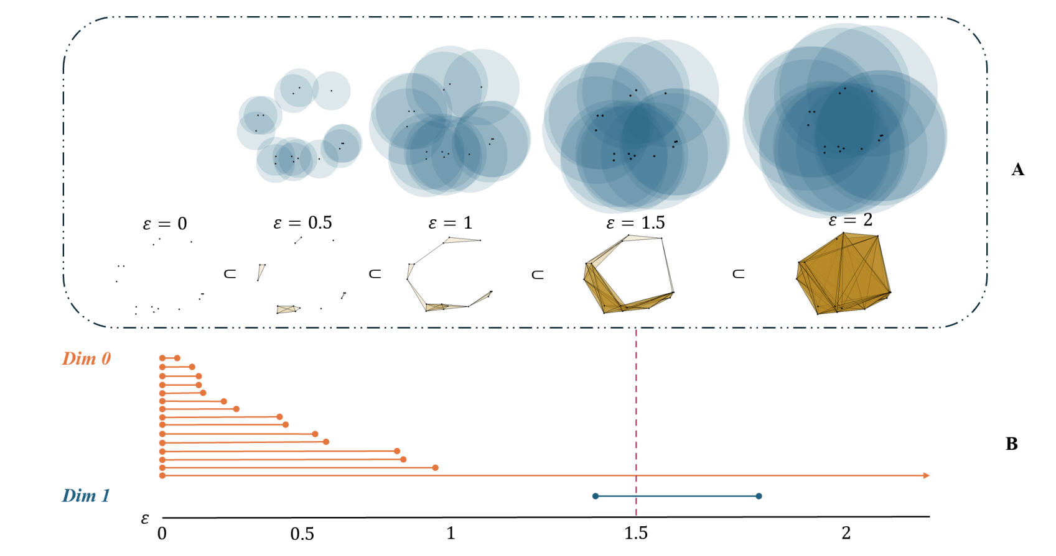
Topological Data Analysis -
Introduction & Background
Methodology
Experiments & Results
Persistent
Homology
Notes:
Our method is based on topological data analysis or more specific persistent homology. So we first go through some brief introduction of this part, and due to time limit, I wont go through the mathematical details.
As we can see from the name persistent homology, it contains 2 part ‘persistent’ and ‘homology’. We will explain them one by one.
The homology part, in one sentences, is to extract the homology groups from simplcial complex constructed from the given dataset. One can construct a simplcial complex based on the distance between the points.(One may think of a growing ball method). We set a parameter \epsilon (radius), if 2 points’ distance based on a given metric is smaller than \epsilon, we connect them together to form a line (1-simplice). If 3 points all within this distance with each other, them form a triangle, similarity k-points form a k-dimensional triangle. After construct the simplicial complex, we calculate the 0 and 1 dimensional homology group. The 0-homology group is the connected component like the point, 1-homology group is the loop structure shown here.
And then the question that how do we choose the parameter \epsilon
Then the things comes to the persistent part. Instead of fix a parameter, we use a continuous one. We grows the epsilon and each will lead to a simplcial complex with homology groups. So we are interested at how the homology group change as the parameter increase. We call this procedure filtration. And we record the parameter of the appear and disappear of each homology group, we call them birth and death time. So as the bar shown here, the left is the birth and right is the death time. The orange part is the 0-dim homology groups like all th epoints. They all birth at 0 directly and gradually die. And the blue one is refer to 1-dim homology group the loops, so you ca see this loop appears before epsilon = 0.5 and die around 1.8

Slide 8
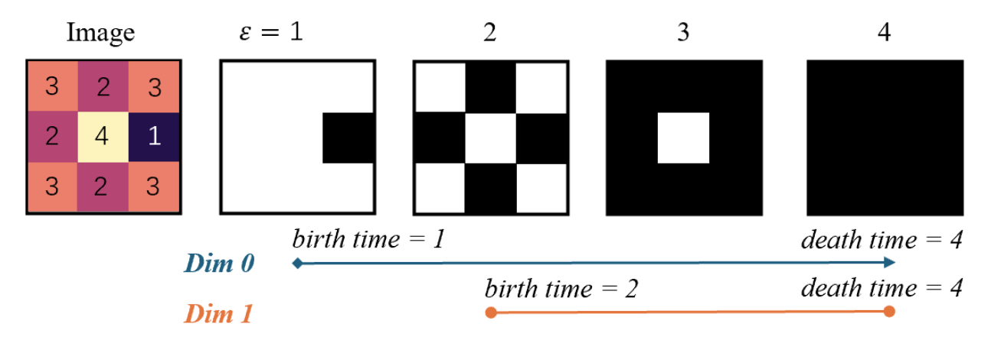
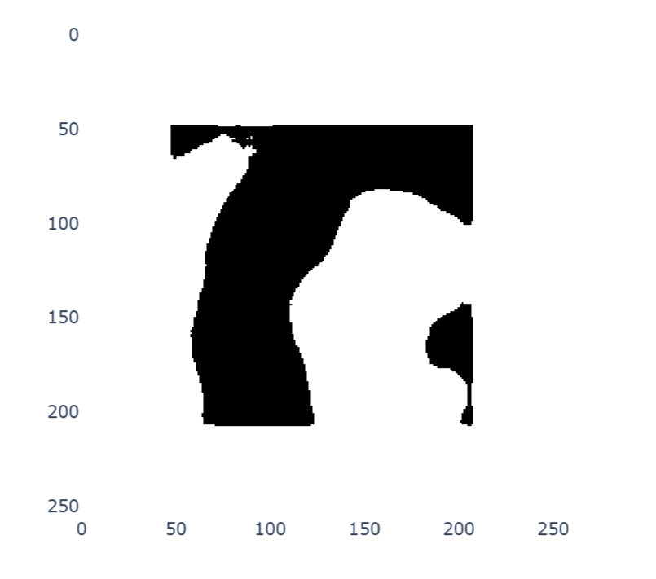
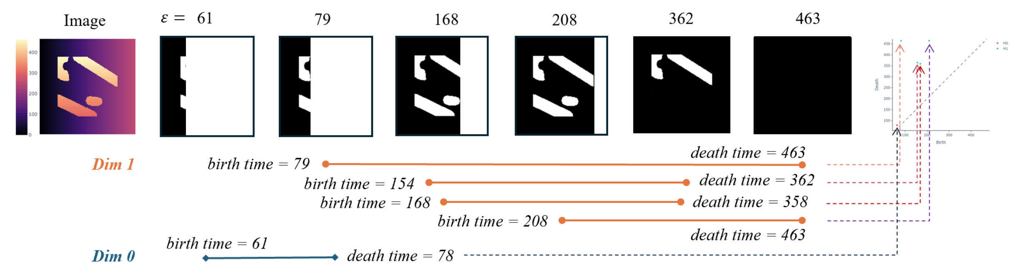
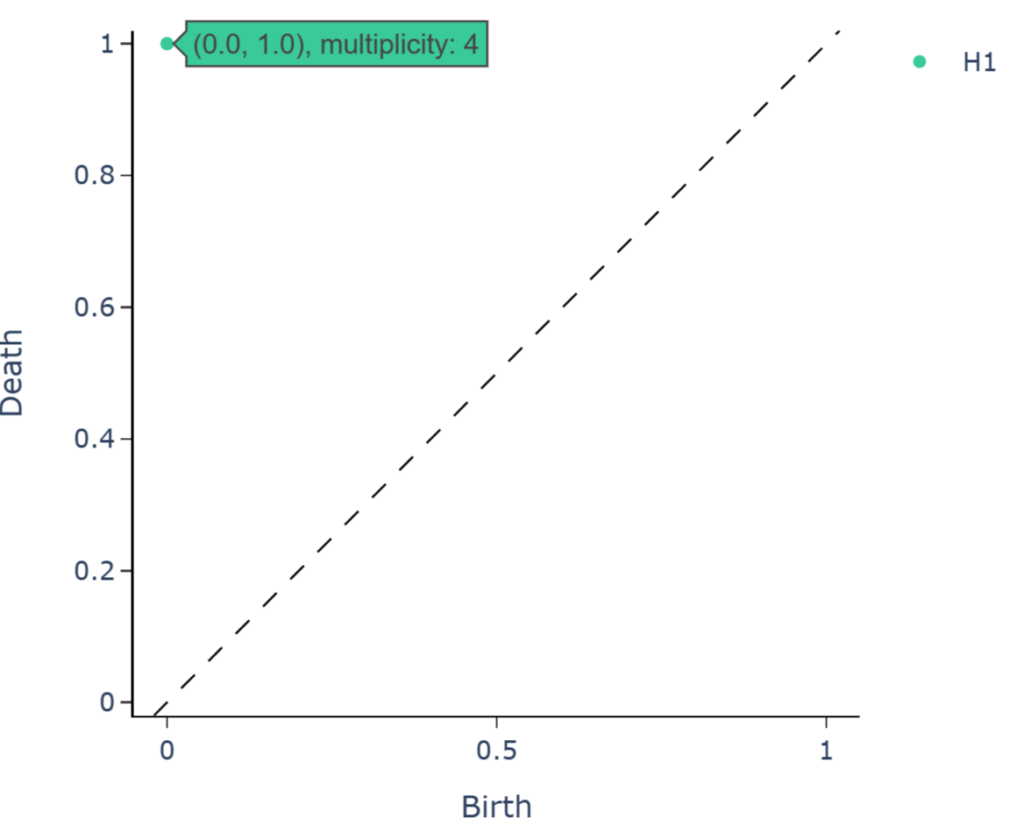
Introduction & Background
Methodology
Experiments & Results
Topological Data Analysis -
Persistent
Homology
filtration of complexes on image
filtration
Persistent Diagram
A filtration process and the formation of a persistent diagram that represents the birth and death of all the 0 and 1-dim homology classes, with 1-dim highlighted
6
Notes:
强调conventional persistent homology might not extract enough information -> we want more
The commonly used persistent homology used to extract the topological features will be perform like this with an image input, they will extract the topological features during the filtration process like this: we add in pixels under a certain threshold, when we increasing the threshold epsilon continuously, we track the changing of topological features especially the birth and death time –refers to the epsilon the topological feature appear and disappear.
However, since over ourput image from the model is a grayscale model and ground truth is binary. If we directly apply the persistent homology on them, will lead to very similar birth and death time. So we want to try to distinguish all the features. Thus we introduce our multi-stage multi-directional filtration here

Slide 9
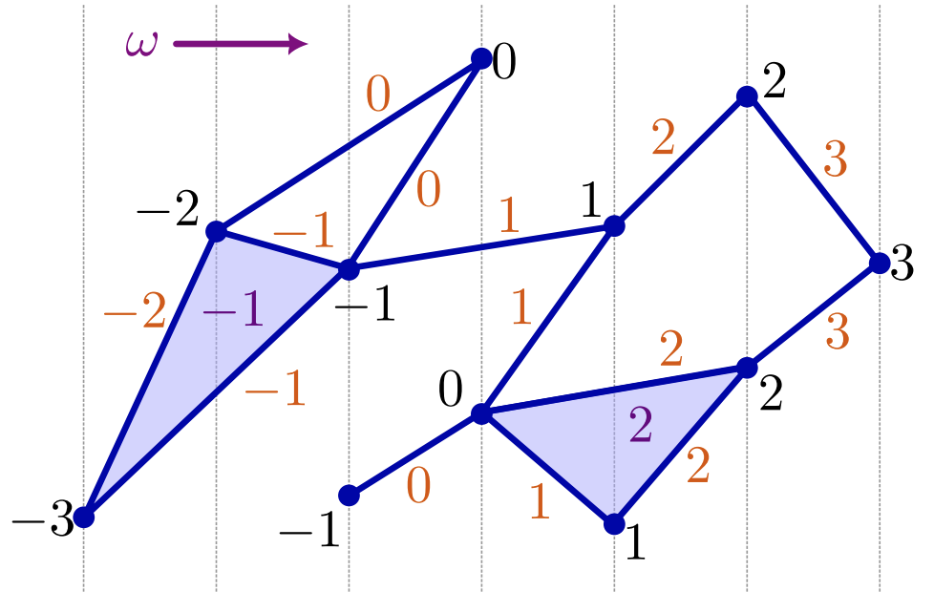
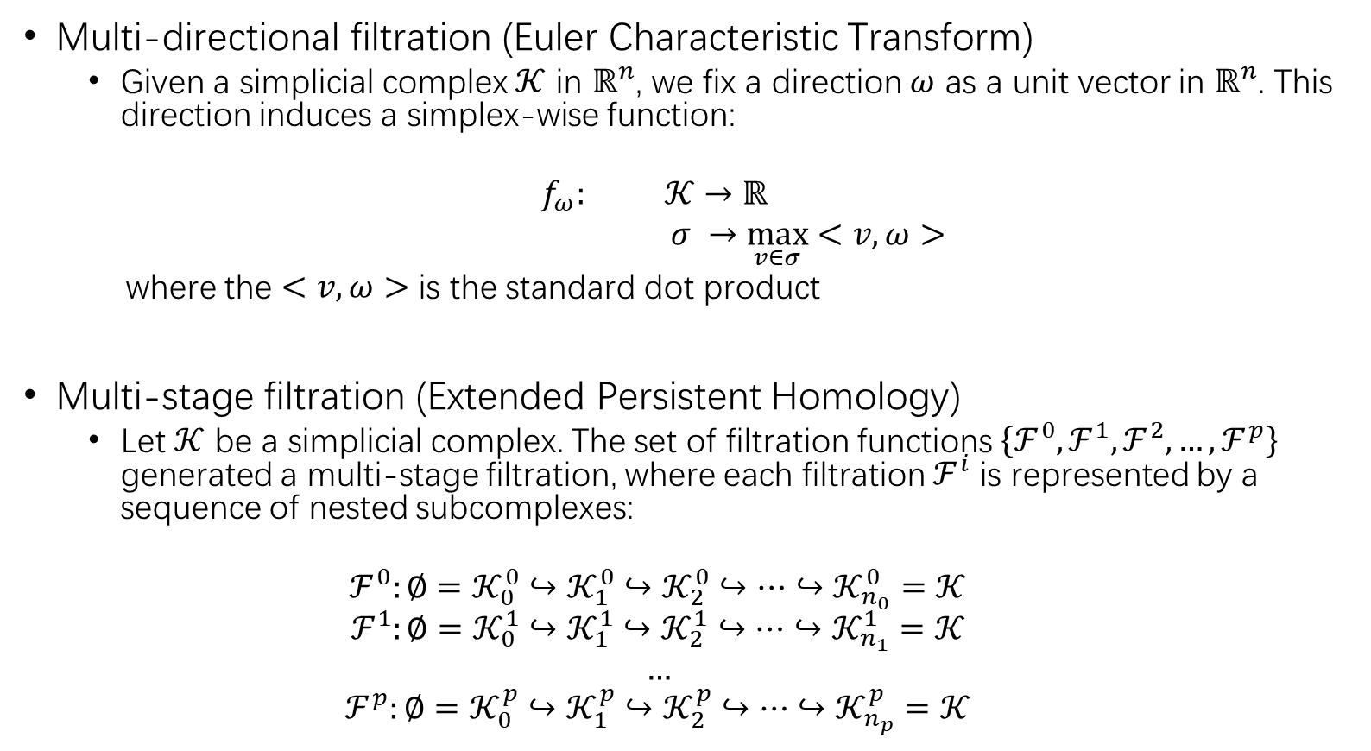
Multi-stage Multi-directional filtration
Introduction & Background
Methodology
Experiments & Results
Multi-directional filtration (Euler Characteristic Transform)
Given a simplicial complex $𝒦$ in $ℝ^{n}$, we fix a direction $ω$ as a unit vector in $ℝ^{n}$. This direction induces a simplex-wise function:
$$f_{ω}: 𝒦→ℝ$$
$σ →\max_{v∈σ}<v, ω>$
where the $<v, ω>$ is the standard dot product
Multi-stage filtration (Extended Persistent Homology)
Let $𝒦$ be a simplicial complex. The set of filtration functions $\left\{ℱ^{0},ℱ^{1},ℱ^{2},…,ℱ^{p}\right\}$ generated a multi-stage filtration, where each filtration $ℱ^{i}$ is represented by a sequence of nested subcomplexes:
$$ℱ^{0}:∅=𝒦_{0}^{0}↪𝒦_{1}^{0}↪𝒦_{2}^{0}↪…↪𝒦_{n_{0}}^{0}=𝒦$$
$$ℱ^{1}:∅=𝒦_{0}^{1}↪𝒦_{1}^{1}↪𝒦_{2}^{1}↪…↪𝒦_{n_{1}}^{1}=𝒦$$
$$…$$
$$ℱ^{p}:∅=𝒦_{0}^{p}↪𝒦_{1}^{p}↪𝒦_{2}^{p}↪…↪𝒦_{n_{p}}^{p}=𝒦$$
7
Notes:
强调more sufficienty represent the topology based on our method
So we introduce our multi-stage multi directional filtration. Where the multi directional means, we assign the a new value to input based on their relative position refer to a given direction. Like the image…. After assign the direction based value, we can do the common filtration. Thus we can express the topological features through different directions’ view. And then we apply the filtration to each direction thus has a multi stage filtration. Which more sufficicently represent the topology.

Slide 10
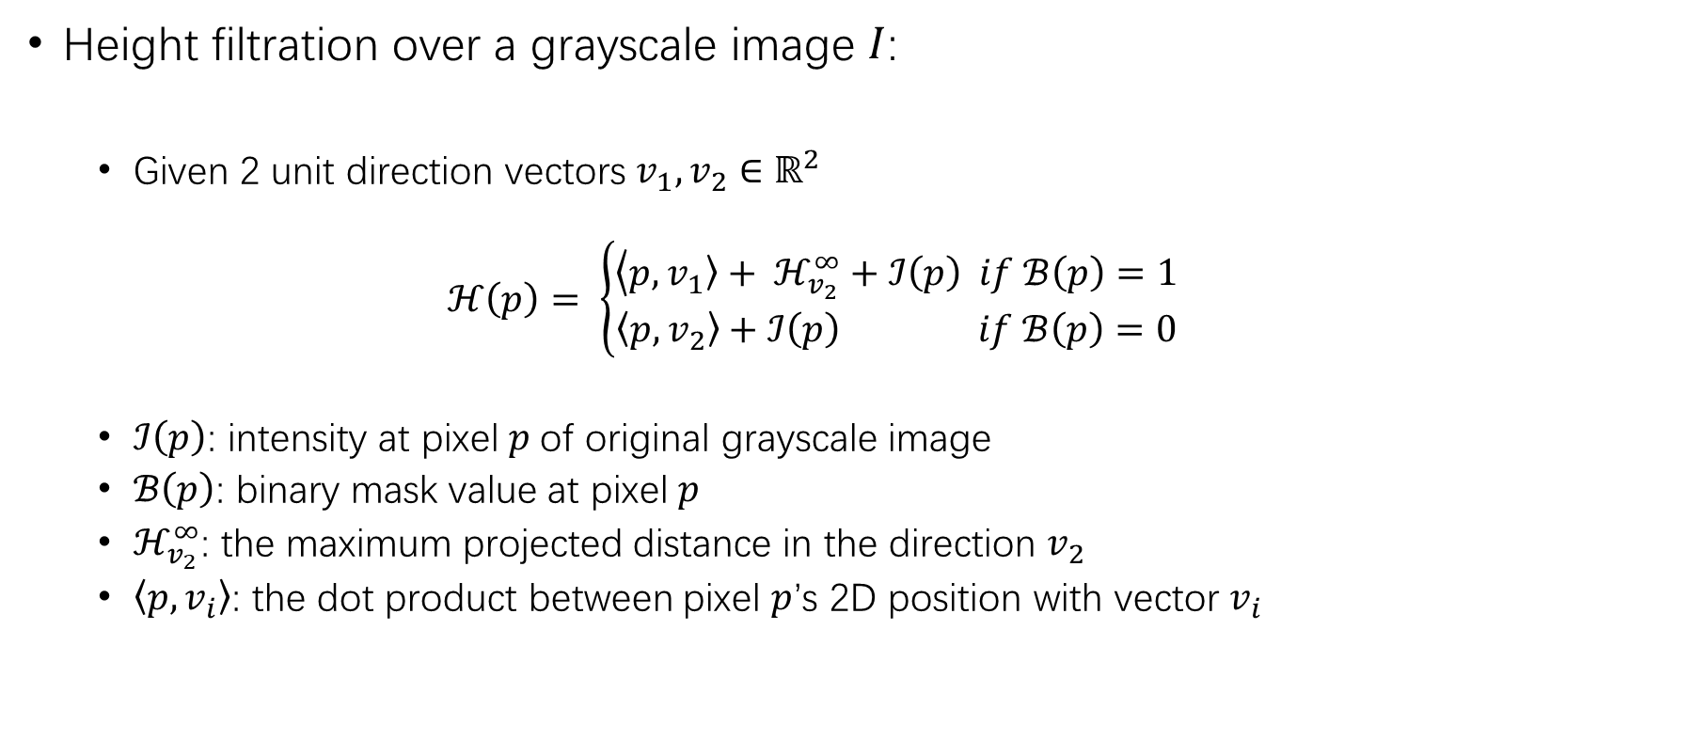
Multi-stage Multi-directional filtration
Introduction & Background
Methodology
Experiments & Results
Height filtration over a grayscale image $I$:
Given 2 unit direction vectors $v_{1},v_{2}∈ℝ^{2}$
$$ℋ\left(p\right)= \left\{\begin{aligned}\left\langle p,\left.v_{1}\right\rangle + ℋ_{v_{2}}^{∞}+ℐ\left(p\right) if ℬ\left(p\right)=1 \right. \\ \left\langle p,\left.v_{2}\right\rangle +ℐ\left(p\right) if ℬ\left(p\right)=0 \right.\end{aligned}\right.$$
$ℐ\left(p\right)$: intensity at pixel $p$ of original grayscale image
$ℬ\left(p\right)$: binary mask value at pixel $p$
$ℋ_{v_{2}}^{∞}$: the maximum projected distance in the direction $v_{2}$
$\left\langle p\right.,\left.v_{i}\right\rangle$: the dot product between pixel $p$’s 2D position with vector $v_{i}$
8
Notes:
How do we actually perform this on image? We design a heigh fiktration over the input grayscale image I, where we assign a new intensity of each pixel p based on this follwoiung equaltion.
Hv2∞ denotes the maximum projected distance in the direction v2, used to offset values such that pixels from different binary classes are properly separated in the filtration

Slide 11
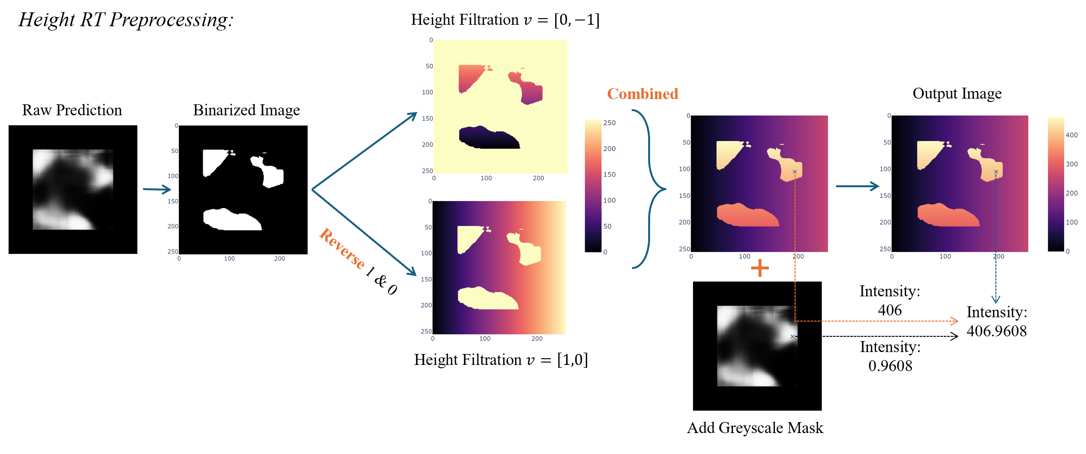
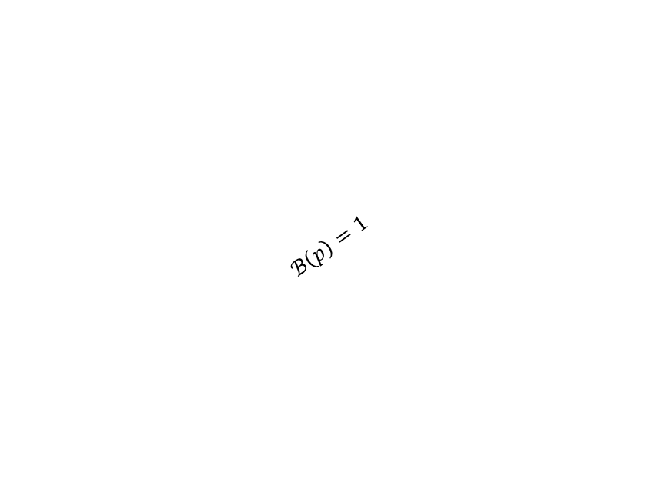

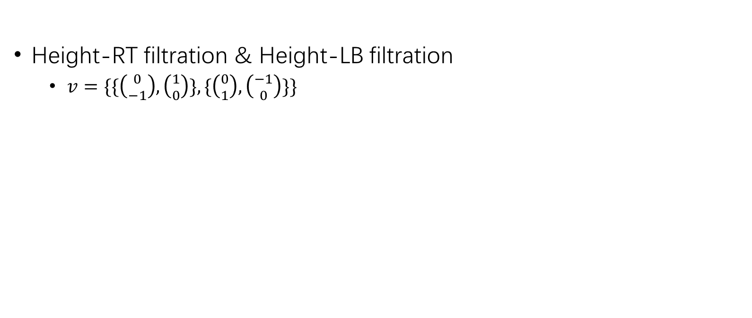
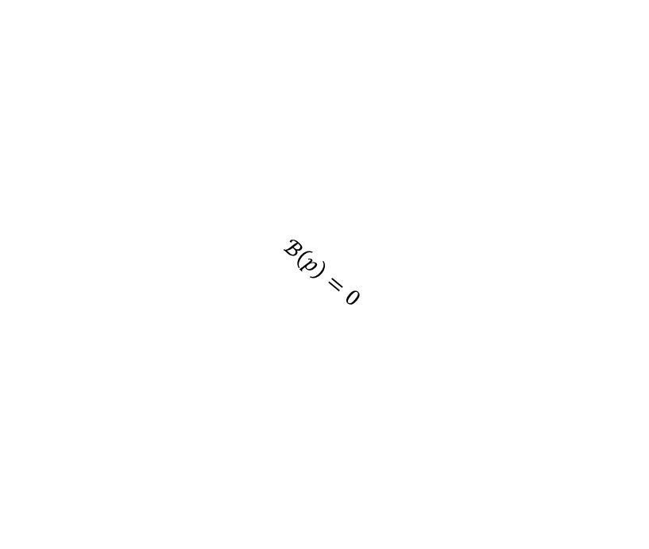
Multi-stage Multi-directional filtration
Introduction & Background
Methodology
Experiments & Results
Height-RT filtration & Height-LB filtration
$v=\{\{\left({0 \atop −1}\right),\left({1 \atop 0}\right)\},\{\left({0 \atop 1}\right),\left({−1 \atop 0}\right)\}\}$
$$ℋ\left(p\right)= \left\{\begin{aligned}\left\langle p,\left.v_{1}\right\rangle + ℋ_{v_{2}}^{∞}+ℐ\left(p\right) if ℬ\left(p\right)=1 \right. \\ \left\langle p,\left.v_{2}\right\rangle +ℐ\left(p\right) if ℬ\left(p\right)=0 \right.\end{aligned}\right.$$
$$v_{1}=\left({0 \atop −1}\right)$$
$$ℬ\left(p\right)=1$$
$$ℬ\left(p\right)=0$$
$$v_{2}=\left({1 \atop 0}\right)$$
a
Image Preprocessing: Height-RT Filtration
9
Notes:
In our actual experiment setting, we choose 2 pairs of v_1 and v_2, which will go horizontally and vertically. We take the first pair as an example, we call it Height-RT filtration with v_1 = (0,-1), and v_2 = (1,0). We binarized the input grayscale image with threshold 0.5, then if B(p)=1 white, we calculate the dot product of each p with v_1 to get the new value on each pixel. Similarity the B(p) = 0 (black part) is for v_2, we combine them together by add up a $ℋ_{v_{2}}^{∞}$ on the first image in order to distinguish between white and black. And then add the original grayscale intensity mask for further differentiabtion. Which results in our output image. Obviously, our output image will have more information based on its new pixel value which is related to direction as well as the output of the deep learning model, which will better express the topological features compare to the original raw prediction 5分20s

Slide 12
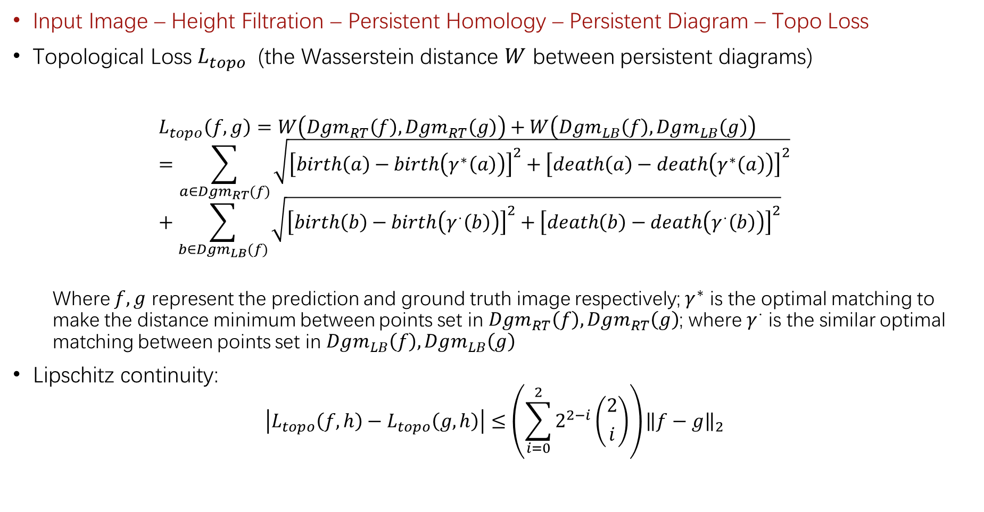

Topological Loss Function $L_{topo}$
Introduction & Background
Methodology
Experiments & Results
Input Image – Height Filtration – Persistent Homology – Persistent Diagram – Topo Loss
Topological Loss $L_{topo}$ (the Wasserstein distance $W$ between persistent diagrams)
$$L_{topo}\left(f,g\right)=W\left(Dgm_{RT}\left(f\right),Dgm_{RT}\left(g\right)\right)+W\left(Dgm_{LB}\left(f\right),Dgm_{LB}\left(g\right)\right)=\sum_{a∈Dgm_{RT}(f)}{\sqrt{{\left[birth\left(a\right)−birth\left(γ^{∗}\left(a\right)\right)\right]}^{2}+{\left[death\left(a\right)−death\left(γ^{∗}\left(a\right)\right)\right]}^{2}}}+\sum_{b∈Dgm_{LB}(f)}{\sqrt{{\left[birth\left(b\right)−birth\left(γ^{⋅}\left(b\right)\right)\right]}^{2}+{\left[death\left(b\right)−death\left(γ^{⋅}\left(b\right)\right)\right]}^{2}}}$$
Where $f,g$ represent the prediction and ground truth image respectively; $γ^{∗}$ is the optimal matching to make the distance minimum between points set in $Dgm_{RT}\left(f\right),Dgm_{RT}\left(g\right)$; where $γ^{⋅}$ is the similar optimal matching between points set in $Dgm_{LB}\left(f\right),Dgm_{LB}\left(g\right)$
Lipschitz continuity:
$$\left|L_{topo}\left(f,h\right)−L_{topo}\left(g,h\right)\right|≤\left(\sum_{i=0}^{2}{2^{2−i}\left({2 \atop i}\right)}\right){\left\|f−g\right\|}_{2}$$
10
Notes:
The Wasserstein distance measure the similarity between diagram, smaller one more similar. 强调Lipschitz
Finally, we define our topological loss function that will put constrain on the topological features during deep learning. We have our f, g represents the image of prediction from neural network and ground truth. We apply the 2 filtrations introduced just now to both of them, and then use the persistent diagram represents the topological features. Our topological loss is defined as the Wasserstein distance between the persistent diagrams. Which will be explicitly written like this: minimum summation of the paired point-wise distancec between the point in diagram of f and the point in diagram of g. since we have 2 filtrations, we calculate separately and combine together.
We also able to prove that they are Lipchitz continuous which leads to the possibility of differentiation.
Rademacher Theorem (Fed´ erer, ´ 1969)). Let U be an open subset of R m and let f : U ← R n be a Lipschitz map. Then f is differentiable almost everywhere.
convergence of the gradient descent Xk+1 := Xk − λ∇Ltopo(Xk) by this Ltopo is purposed by the theorem in (

Slide 13
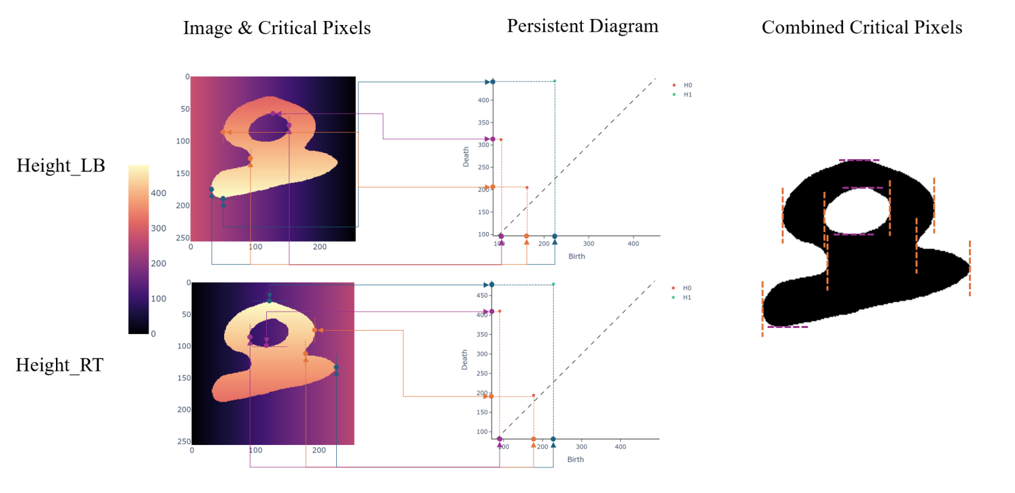
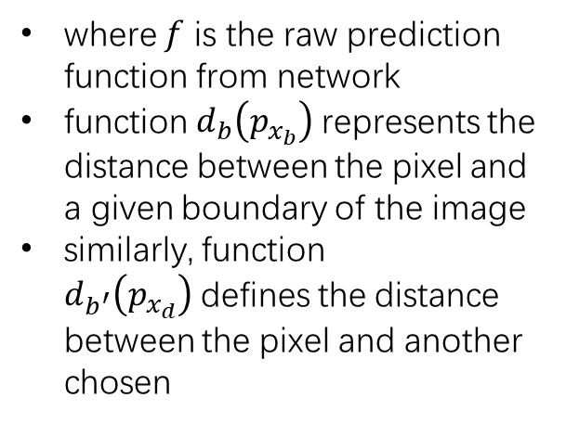
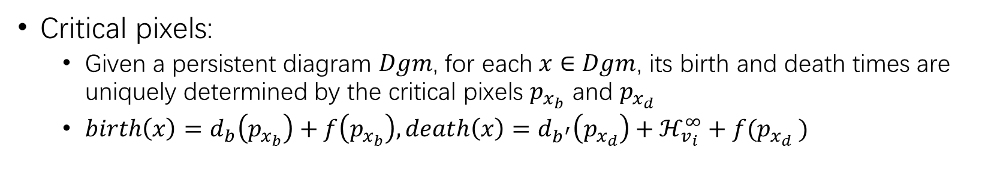

Topological Loss Function $L_{topo}$
Introduction & Background
Methodology
Experiments & Results
$$ℋ\left(p\right)= \left\{\begin{aligned}\left\langle p,\left.v_{1}\right\rangle + ℋ_{v_{2}}^{∞}+ℐ\left(p\right) if ℬ\left(p\right)=1 \right. \\ \left\langle p,\left.v_{2}\right\rangle +ℐ\left(p\right) if ℬ\left(p\right)=0 \right.\end{aligned}\right.$$
Critical pixels:
Given a persistent diagram $Dgm$, for each $x∈Dgm$, its birth and death times are uniquely determined by the critical pixels $p_{x_{b}}$ and $p_{x_{d}}$
$birth\left(x\right)=d_{b}\left(p_{x_{b}}\right)+f\left(p_{x_{b}}\right), death\left(x\right)=d_{b^{′}}\left(p_{x_{d}}\right)+ℋ_{v_{i}}^{∞}+f(p_{x_{d}} )$
where $f$ is the raw prediction function from network
function $d_{b}\left(p_{x_{b}}\right)$represents the distance between the pixel and a given boundary of the image
similarly, function $d_{b^{′}}\left(p_{x_{d}}\right)$defines the distance between the pixel and another chosen
11
Notes:
强调很难去对Topoloss做differentiation,虽然lipchitz但是似乎not related with pixel -》 我们使用critical pixel
Convex and concave
How do we actually differentiate this loss function? -> since we need to differentiable towards the prediction output of each pixel, we try to see the functions’ relation between pixels and their prediction value.

Slide 14
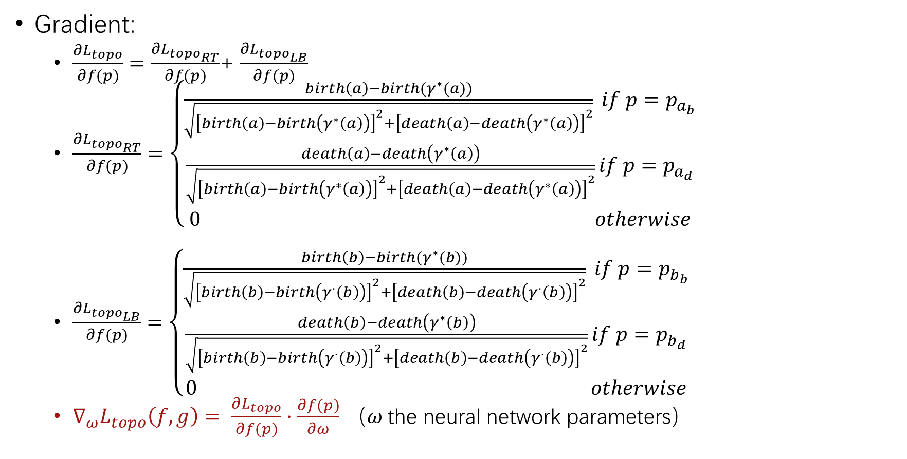
Topological Loss Function $L_{topo}$
Introduction & Background
Methodology
Experiments & Results
Gradient:
$\frac{∂L_{topo}}{∂f(p)}=\frac{∂L_{topo_{RT}}}{∂f(p)}$+ $\frac{∂L_{topo_{LB}}}{∂f(p)}$
$\frac{∂L_{topo_{RT}}}{∂f(p)}=\left\{\begin{aligned}\frac{birth\left(a\right)−birth(γ^{∗}(a))}{\sqrt{{\left[birth\left(a\right)−birth\left(γ^{∗}\left(a\right)\right)\right]}^{2}+{\left[death\left(a\right)−death\left(γ^{∗}\left(a\right)\right)\right]}^{2}}} if p=p_{a_{b}} \\ &\frac{death\left(a\right)−death\left(γ^{∗}\left(a\right)\right)}{\sqrt{{\left[birth\left(a\right)−birth\left(γ^{∗}\left(a\right)\right)\right]}^{2}+{\left[death\left(a\right)−death\left(γ^{∗}\left(a\right)\right)\right]}^{2}}}if p=p_{a_{d}} \\ 0 otherwise\end{aligned}\right.$
$\frac{∂L_{topo_{LB}}}{∂f(p)}=\left\{\begin{aligned}\frac{birth\left(b\right)−birth(γ^{∗}(b))}{\sqrt{{\left[birth\left(b\right)−birth\left(γ^{⋅}\left(b\right)\right)\right]}^{2}+{\left[death\left(b\right)−death\left(γ^{⋅}\left(b\right)\right)\right]}^{2}}} if p=p_{b_{b}} \\ &\frac{death\left(b\right)−death\left(γ^{∗}\left(b\right)\right)}{\sqrt{{\left[birth\left(b\right)−birth\left(γ^{⋅}\left(b\right)\right)\right]}^{2}+{\left[death\left(b\right)−death\left(γ^{⋅}\left(b\right)\right)\right]}^{2}}}if p=p_{b_{d}} \\ 0 otherwise\end{aligned}\right.$
$∇_{ω}L_{topo}\left(f,g\right)= \frac{∂L_{topo}}{∂f(p)}⋅\frac{∂f(p)}{∂ω}$ （$ω$the neural network parameters）
12
Notes:
强调all in all we design了一个 express sufficient topological features的loss function and which is also differentiable and able for gradient descent
3分钟

Slide 15
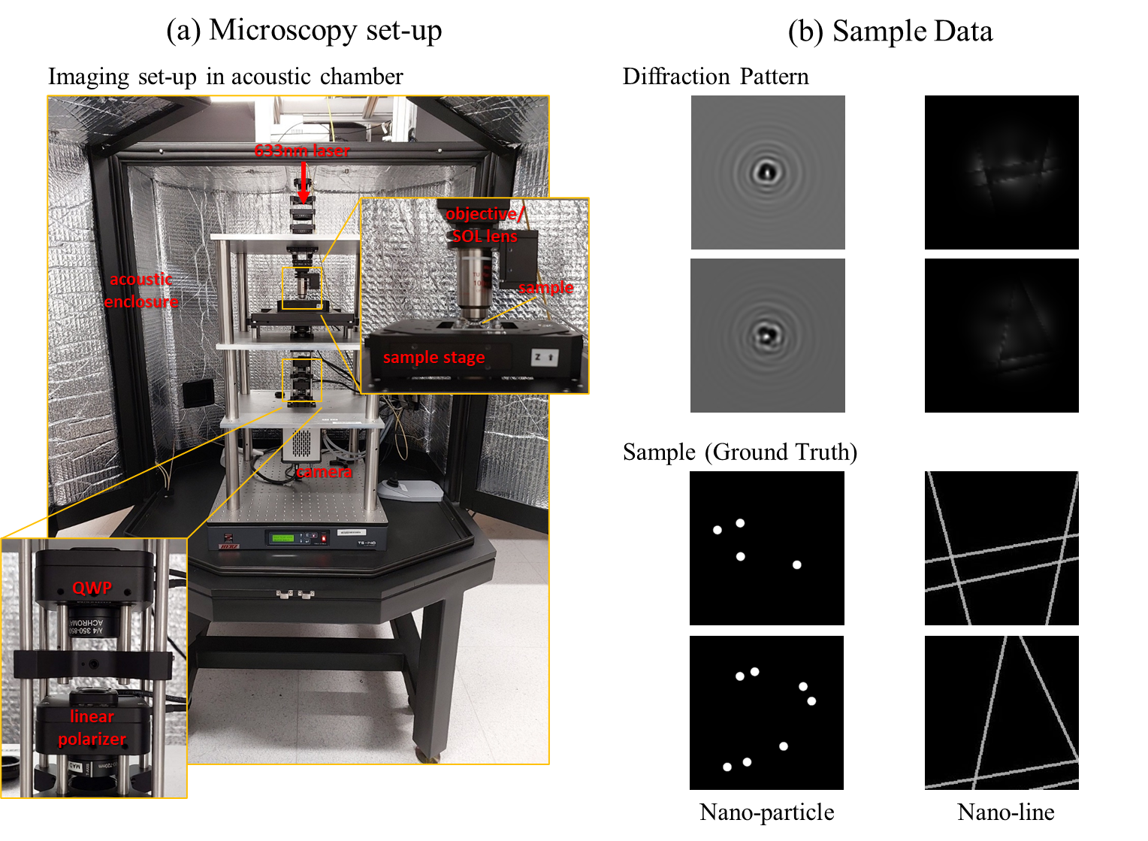
Datasets
Introduction & Background
Methodology
Experiments & Results
Microscopic Imaging
Dataset 1: Nano-particle
Dataset 2: Nano-line
13
Notes:
We do the real implementation of our method on 2 kind of dataset getting from this microscopy with both the dif
To acquire high-quality subwavelength optical images, we use a custom-built ultra-precision microscopy system with stabilization methods to minimize mechanical drift and environmental noise as shown in Figure 4-1(a). The setup employs a 633 nm coherent light source in a vertically aligned configuration, achieving an effective pixel size of 41.7 nm on the sample plane. A linearly polarized beam is focused onto the sample via a high-numerical-aperture objective mounted on a precision piezoelectric stage. The transmitted diffraction signals are detected by a highsensitivity sCMOS camera positioned in the far field. To ensure stability, the optical system is mounted on a vibration isolation platform, and an acoustic enclosure minimizes environmental noise.
420s

Slide 16
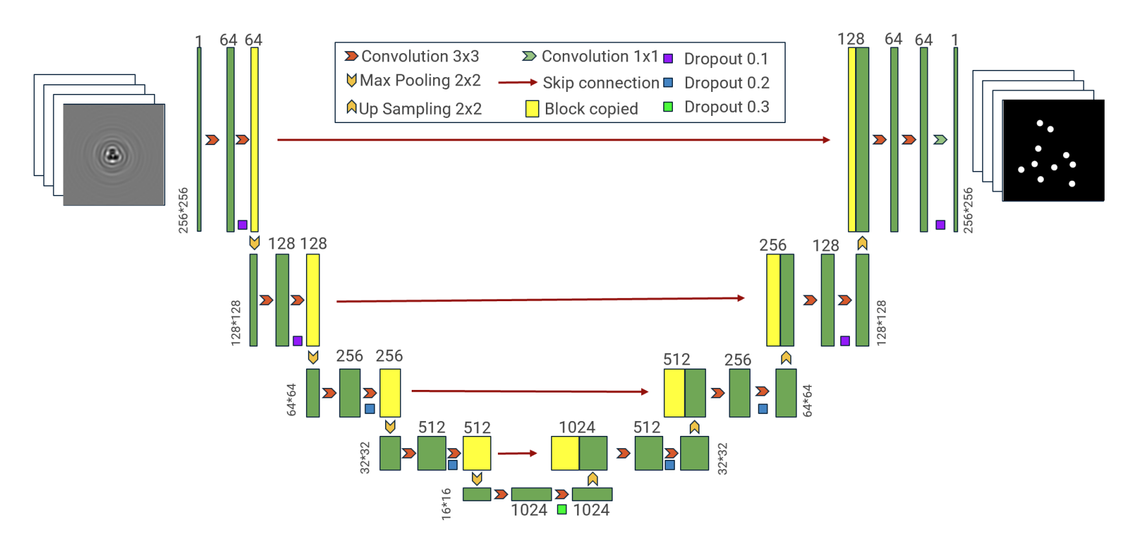
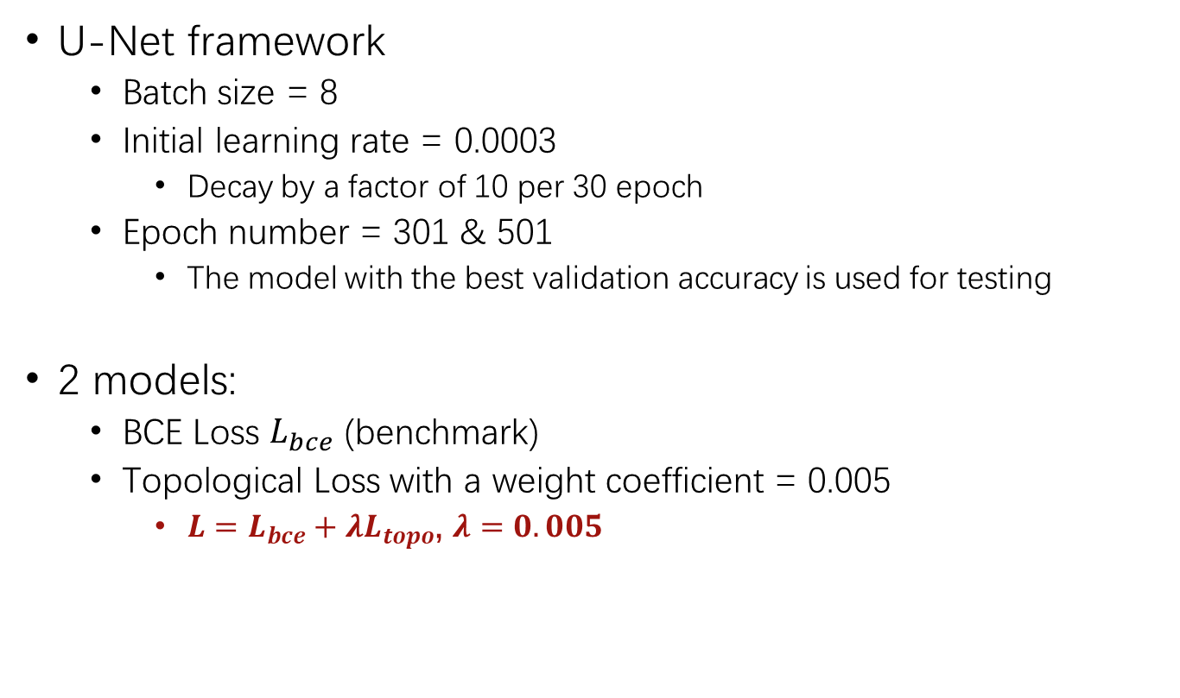
Experiment Setup
Introduction & Background
Methodology
Experiments & Results
U-Net framework
Batch size = 8
Initial learning rate = 0.0003
Decay by a factor of 10 per 30 epoch
Epoch number = 301 & 501
The model with the best validation accuracy is used for testing
2 models:
BCE Loss $L_{bce}$ (benchmark)
Topological Loss with a weight coefficient = 0.005
$L=L_{bce}+λL_{topo}$, $λ=0.005$
14
Notes:
Deep learning has been widely applied to optical imaging, with recent work such as (Yang et al., 2021)(Hu et al., 2024) using U-Net for nanoparticle and nanowire imaging. However, its pixel-wise loss function often leads to structural discontinuities, failing to preserve the connectivity of fine structures such as nanowires.

Slide 17
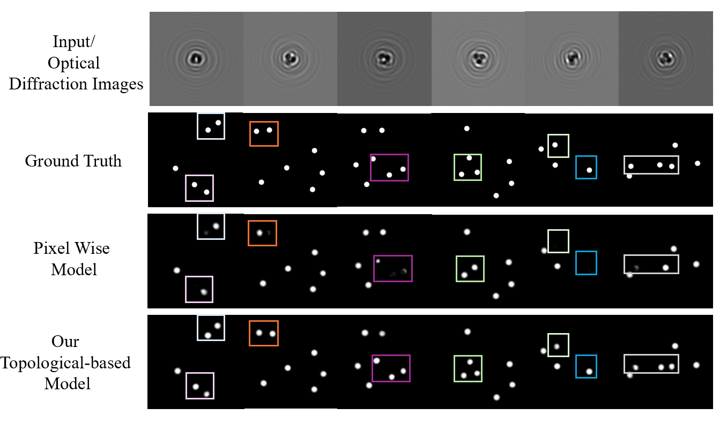
Results: Nano-particle
Introduction & Background
Methodology
Experiments & Results
Model | MSE | Pearson Correlation | Precision | Recall | F1 | Jaccard Index
Pixel-wise Model | 0.0134 | 0.4275 | 0.4275 | 0.4848 | 0.4149 | 0.2726
Our Model | 0.0103 | 0.6324 | 0.6390 | 0.6031 | 0.6203 | 0.4518
Notes:
多说 多对比

Slide 18
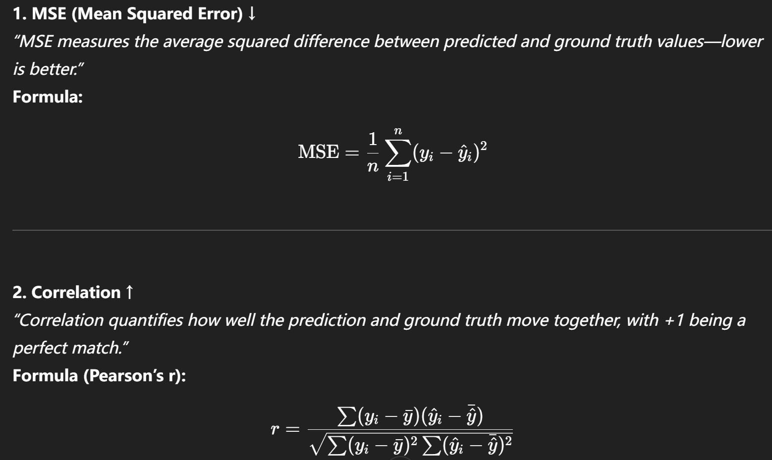
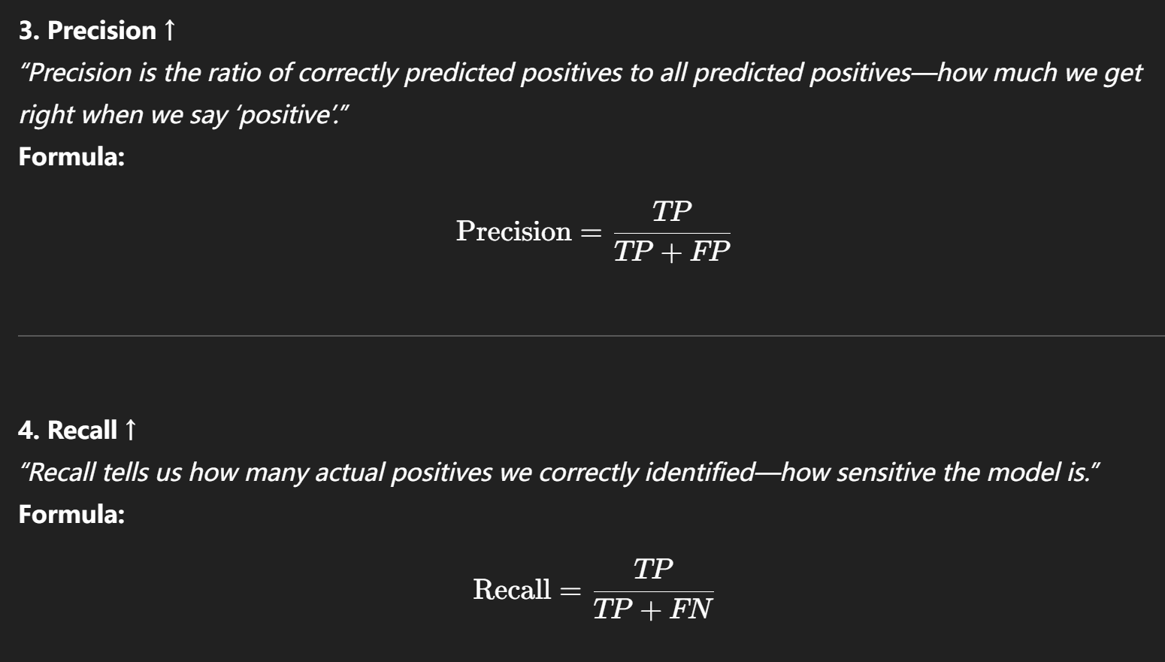
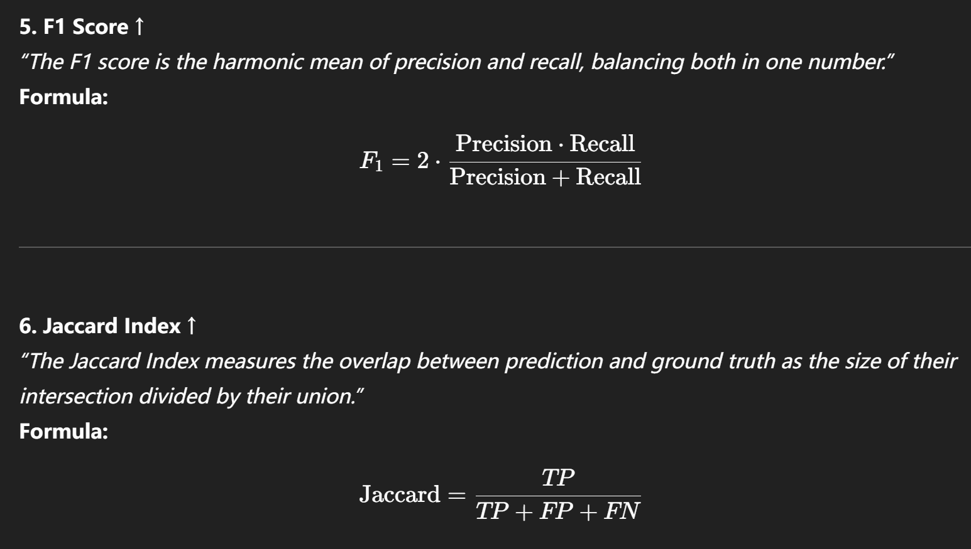
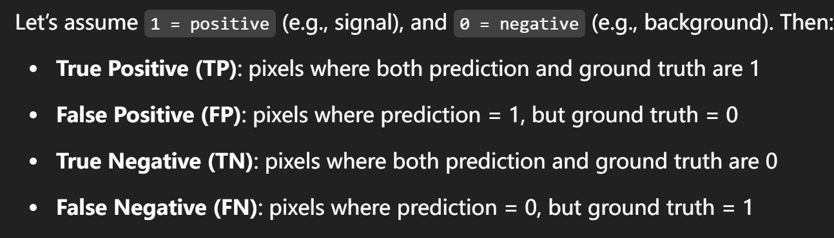
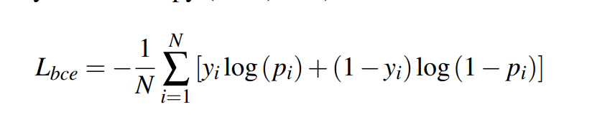




Slide 19
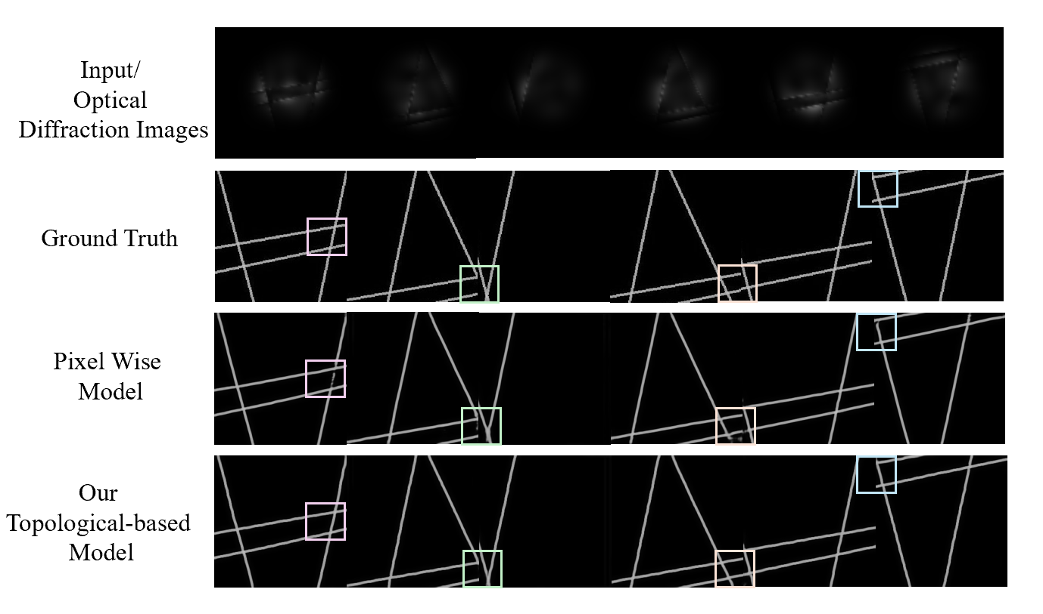
Results: Nano-line
Introduction & Background
Methodology
Experiments & Results
Model | MSE | Pearson Correlation | Precision | Recall | F1 | Jaccard Index
Pixel-wise Model | 0.0135 | 0.8679 | 0.8032 | 0.9546 | 0.8723 | 0.7748
Our Model | 0.0122 | 0.9040 | 0.8551 | 0.9692 | 0.9086 | 0.8327
Notes:
多说 多对比

Slide 20
Conclusion
Introduction & Background
Methodology
Experiments & Results
Topology-preserving deep learning framework for optical semiconductor characterization at deeply subwavelength resolution
Experimental results of nano-line dataset demonstrated a ~5% improvement in evaluation metrics compared to pixel-wise model
Experimental results of nano-particle dataset demonstrated a ~30% improvement in evaluation metrics.
17
Notes:
Need a call back with the introduction!!!!!!!!!!!!!!
Deep learning has been widely applied to optical imaging, with recent work such as (Yang et al., 2021)(Hu et al., 2024) using U-Net for nanoparticle and nanowire imaging. However, its pixel-wise loss function often leads to structural discontinuities, failing to preserve the connectivity of fine structures such as nanowires.

Slide 21
Future Work
Introduction & Background
Methodology
Experiments & Results
Publications:
Accepted (Oral) AI4X 2025 International Conference
Wang, B., An, R., So, J.-K., Kurdiumov, S., Chan, E. A., Adamo, G., Peng, Y., Li, Y., & An, B. (2025). OpticalNet: An Optical Imaging Dataset and Benchmark Beyond the Diffraction Limit. CVPR 2025
Future work:
More Flexible Directional Filtration: e.g. gradient descent direction
Topological Photonics Datasets
18
Notes:
Deep learning has been widely applied to optical imaging, with recent work such as (Yang et al., 2021)(Hu et al., 2024) using U-Net for nanoparticle and nanowire imaging. However, its pixel-wise loss function often leads to structural discontinuities, failing to preserve the connectivity of fine structures such as nanowires.
3.5分钟

